Slide 1
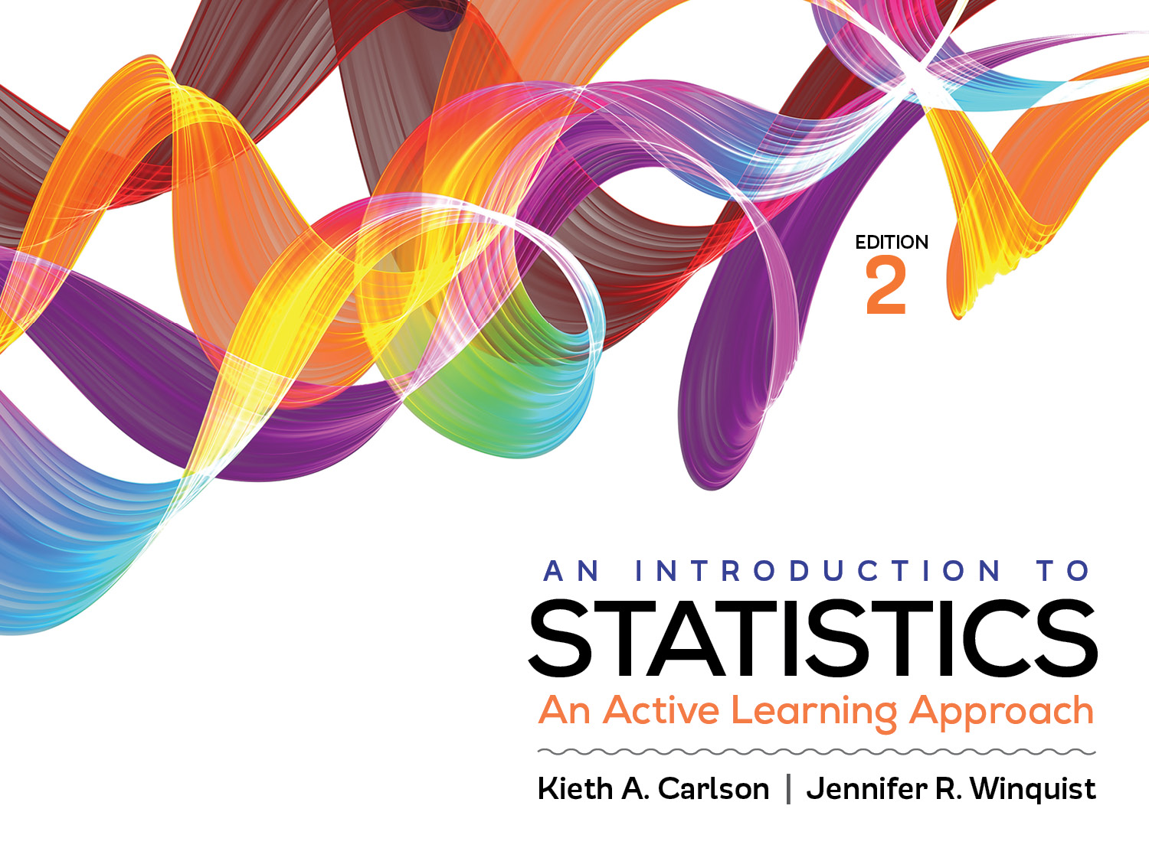
Introduction to Activity 12.5
Choosing the Correct Statistic

Slide 2
Activity 12.5 will require you to:
Choose the correct significance test for a given scenario
If necessary use Appendix J to help you

Slide 3
Which significance test and why?
Do enjoyment scores differ between kids who go to Disneyworld vs. Disneyland?
Do socio-economic (i.e., below average, average, and above average) and geographical region (i.e., South, Midwest, and Northeast) jointly influence attitudes on health care reform?
People are paired on their pre-existing attitudes towards a political candidate, then one from each pair watched a negative ad about that candidate. Did the ad lower peoples attituded about this candidate?
Is current health status (i.e., below average, average, and above average) associated with happiness score?
Are the students’ ratings of this course lower than the colleges’ average?
Notes:
Independent t test
2-way ANOVA
Matched design, use related/repeated t test
1-way ANOVA
Single sample t test

